Slide 1
Basic Details of the Team and Problem Statement
PSID: KVH-009
Problem Statement Title: Advanced CCTV analytics solution
Team Name: PLMSquared
Team Leader Name: Prasanna VB
Institute Code (AISHE): 1-36531100771
Institute Name: Sri Venkateswara College Of Engineering

Slide 2
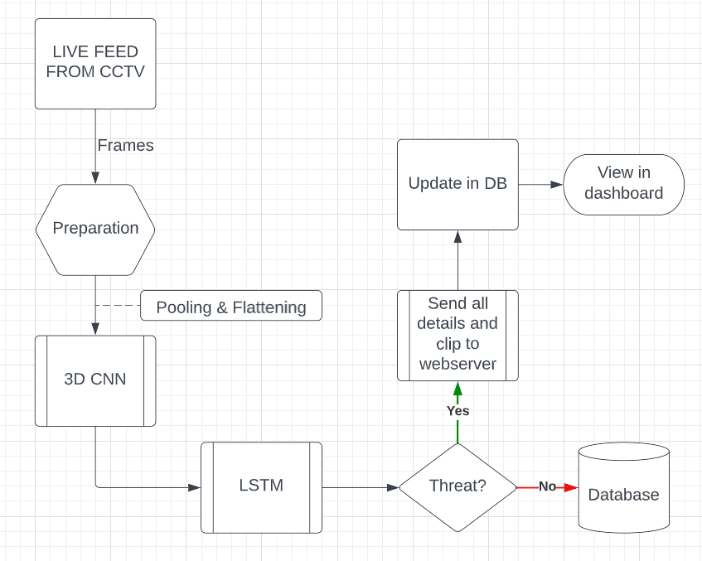
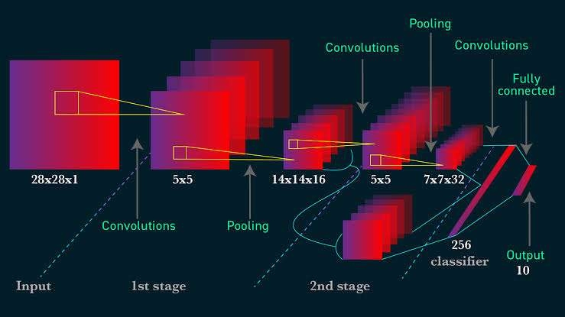
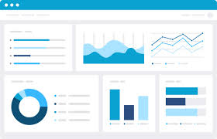
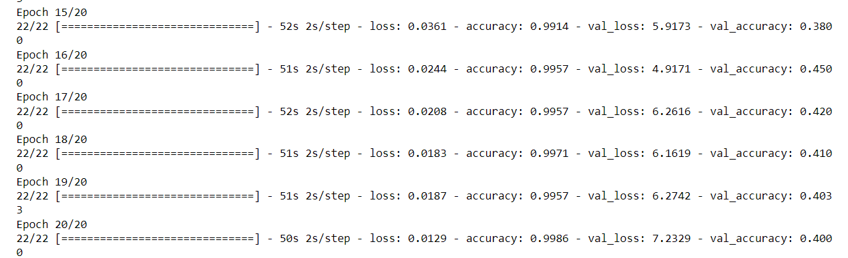
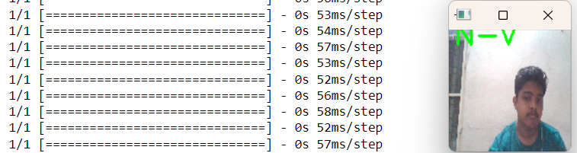
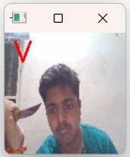
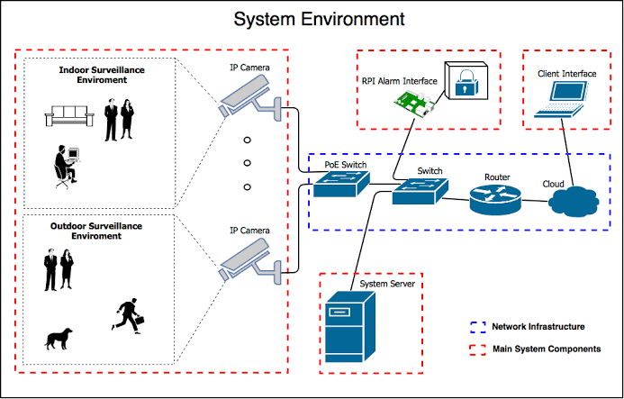
Idea/Approach Details
The live feed from CCTV is taken as input in the form of frames which are then preprocessed and fed into the input layer of 3D – CNN. Advantage of using 3D - CNN is its enhanced ability to analyze the difference between each frame in a continuos stream.
The frames then undergo pooling and flattening whose output is then fed to the input layer of the LSTM which analyzes the data sequentially and performs threat detection & categorizes the type of threat and its risk level.
3D-CNN is able to predict the threat and the addition of LSTM layer increases the accuracy of the prediction, categorizing the threat etc.
If threat is detected, the details such as region, category, time, risk level etc are sent to the backend which are reflected in the dashboard. Police officials are able to view these details, and also the clip which has been analyzed and shortened in the dashboard.
The alert is then viewed by the police official, who can approve or disapprove the alert after review. If the threat is accurate, both the victim and perpetrator are identified using facial recognition and an alert is sent to the victims families through the government authorities.
The admin (higher officials)also has access to request to send other resources such as firefighters or medical to the victims location.
The dashboard contains access to the overall data pertaining to the region of control, such as types of threats, intensity etc and these data are visualized at the dashboard.
The government authorities can view data pertaining to their control level along with visualization based one analysis of different data such as crime rate, types of crime and other such filters.
Different zones (red - high crime, green - low crime etc) are assigned to areas with varying crime rates which upon changes alerts the concerned authorities.

Slide 3
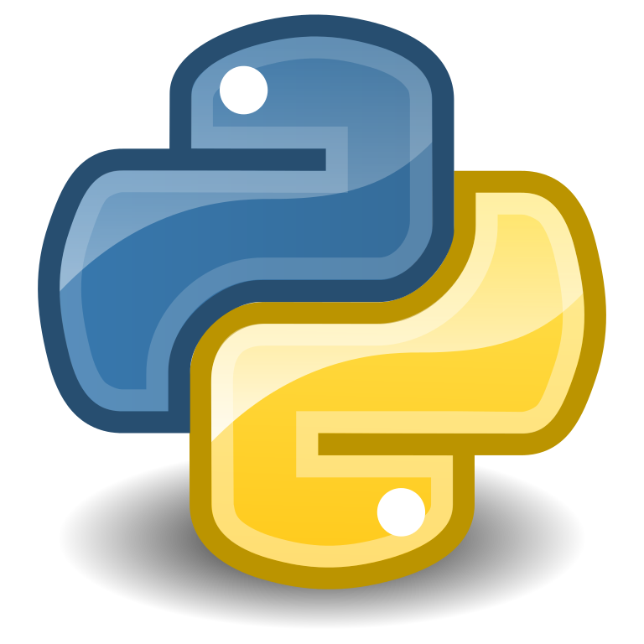




Use Cases :-
Trespassing Detection: The system is used to identify intrusion attempts into private or secluded areas.
Crowd Monitoring: Big groups or gatherings are watched over for any potential dangers or disturbance.
Object Tracking: Involves tracking specific objects, such as vehicles, weapons or packages, to identify any potential security risks.
Aggression Detection: This system can be used to track violence ,physical attack, harassment etc.
Theft Detection : The system will detect theft /robbery from the live feed
Alert System : The model will generate alert on detection of threat and necessary actions can be taken immediately.
Unattended object detection: The model will detect unattended object over long period and raise alert message
Crime prone area detection: The system identify the area with high crime rate using the threat data stored in database and security can be tightened.
Dependencies:-
High resolution camera which can capture maximum details even in low light or high noise conditions.
High speed internet connection to communicate to cloud.
Powerful cloud server which can host and run the threat analysis model on multiple clips concurrently,
A low ping web server which can alert details of threats immediately to the concerning government agencies.
Large cloud storage to hold backup for at least one week at maximum resolution.
Show Stopper:-
Rural areas might have a slow setup due to internet speed limitations.
Cost and resources required to host and run the model is very high for video processing of a higher calibre (which is in turn required for a higher accuracy)
Storage of multitude of high resolution video data is highly expensive and hence local and inhouse solutions have to be adapted.
Initial training of the model over various types of threats is challenging, however it can be improved further by using the live data.
Business Scope :-
Private organization: The threat detection model and analytics dashboard can be customized and system can be employed to suite the different needs of private organizations. The database and storage for the clips and CCTV footage can be offered as a monthly subscription alongside maintenance and model updation.
Technology Stack :-
video analysis model:
python(tensorflow , keras , scikit learn , seaborn , matplotlib )
Django (web framework for backend server ) .
Dashboard:

Slide 4
Team Member Details
Sr. No. | Name of Team Member | Branch (Btech/Mtech/PhD etc): | Stream (ECE, CSE etc): | Year | Position in team (Team Leader, Front end Developer, Back end Developer, Full Stack, Data base management etc.)
1 | Prasanna VB | B.E. | CSE | II | Team leader, Frontend dev
2 | Praveen C | B.E. | CSE | II | Full stack dev
3 | Lokesh Varathan M | B.E. | CSE | II | Full stack dev
4 | Mathivanan R | B.E. | CSE | II | AI/ML dev, Backend dev
5 | Mythreye S | B.E. | CSE | II | AI/ML dev, Backend dev
6 | Logesh S | B.E. | CSE | II | AI/ML dev, Backend dev
Team Mentor/s Details
Sr. No. | Name of Mentor | Category (Academic/Industry): | Expertise (AI/ML/Blockchain etc): | Domain Experience (in Years )
1 | Janakasudha G | Academic | AI/ML | 12

